Slide 1
Customer Relationship Manager

Slide 2
AGENDA
Introduction​
Objective
Purpose
Team
Project Scope
​Modules
Project Design
​

Slide 3
Introduction
Customer Relationship Management (CRM) is a well-known system for managing an organization’s communications with customers, clients, and sales prospects. This system uses technology for organizing, synchronizing, and automating business and sales activities. This is a virtual system and this system does not require any physical offices or environment. So, everybody can use this system easily. Administrators can communicate and provide services through this system, and also users can access and check their status and project opportunities, get more information about the projects, and update systems.

Slide 4
Objective
• For simplifying marketing and sales system.
• For providing better customer service.
• For discovering new customers and raising customer profit.
• For increasing cross-sell products more effectively.
The Customer Relationship Management (CRM) system needs to support all the basic steps of the customer life cycle.

Slide 5
Purpose
The purpose of the CRM system is to:
• Maintain good relationship with the customer
• Manage business opportunity
• Lead Management
• Track the business opportunity and develop it
• Daily Meetings, Task, Note, and Emails with contacts or leads
• Alert Notification for meeting or call
• Customer Observation

Slide 6
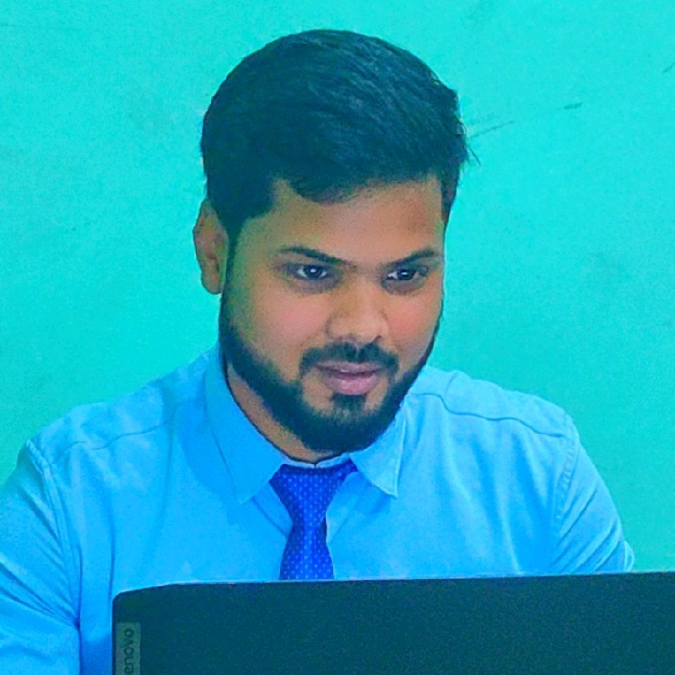
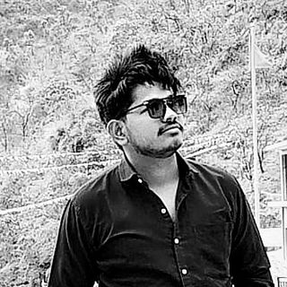
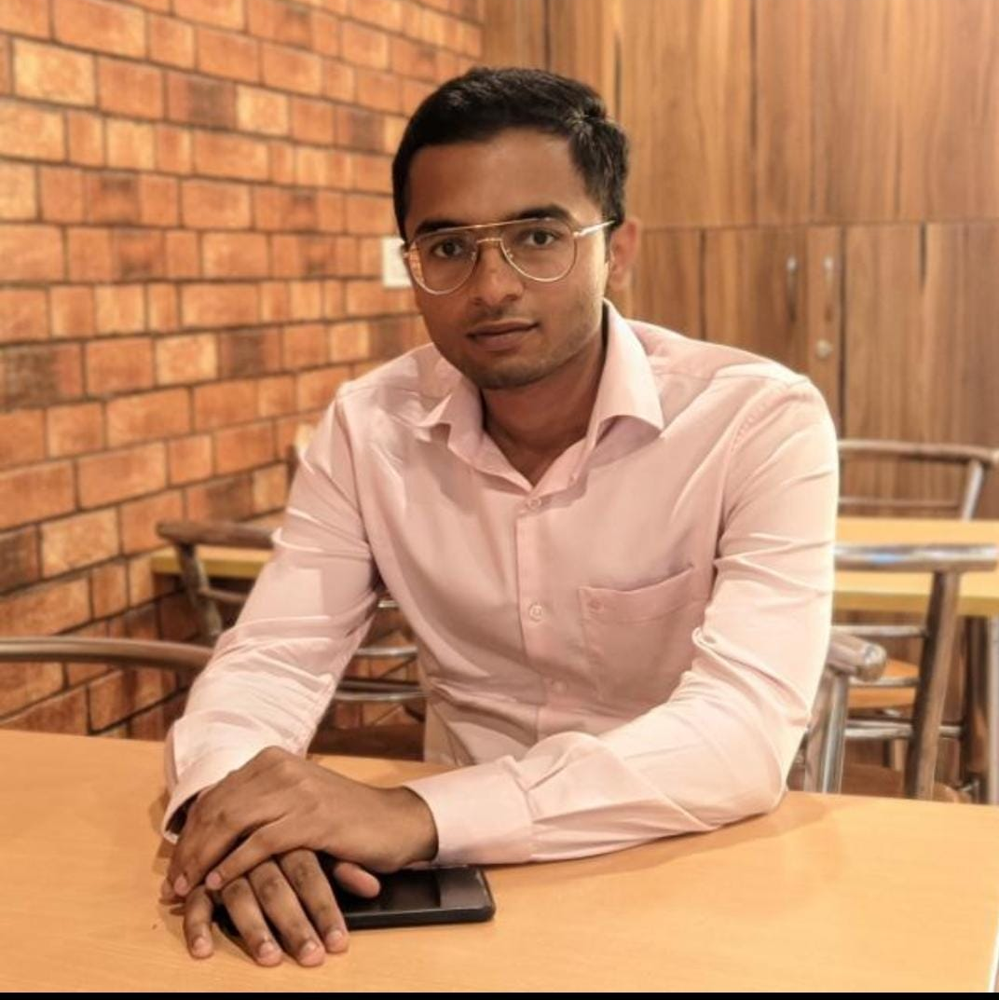

MEET OUR TEAM
Arnav singh
Harish
Himanshu saini
FLORA BERGGREN​
Chief Operations Officer

Slide 7
Project scope
This entire CRM system is web based and creating on open source applications and software. This system is developed in PHP (Laravel Framework) with apache web server and database is MySQL. Also included Node JS for User Notification. It is eligible and compatible for every web browser and operating system

Slide 8
Modules
Sign up/ Sign in
Admin Panel
User Panel
Raise Ticket
Universal search
Create Quote
Create Users

Slide 9
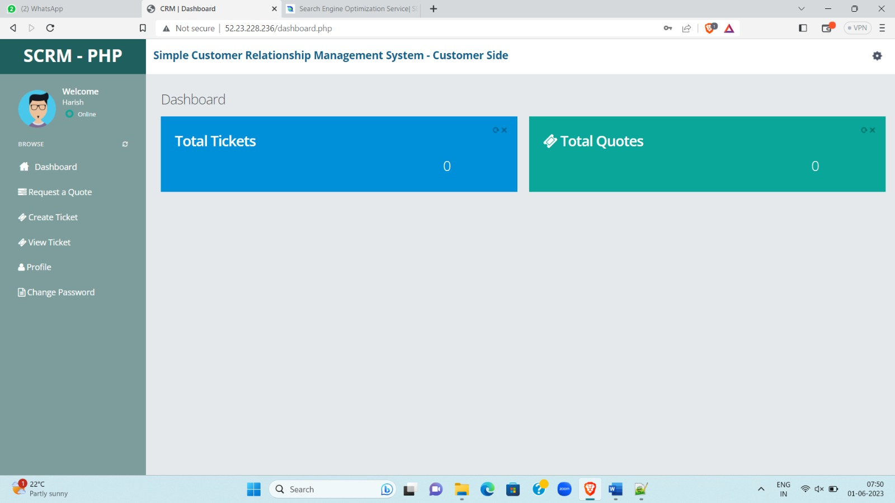
Project Design

Slide 10
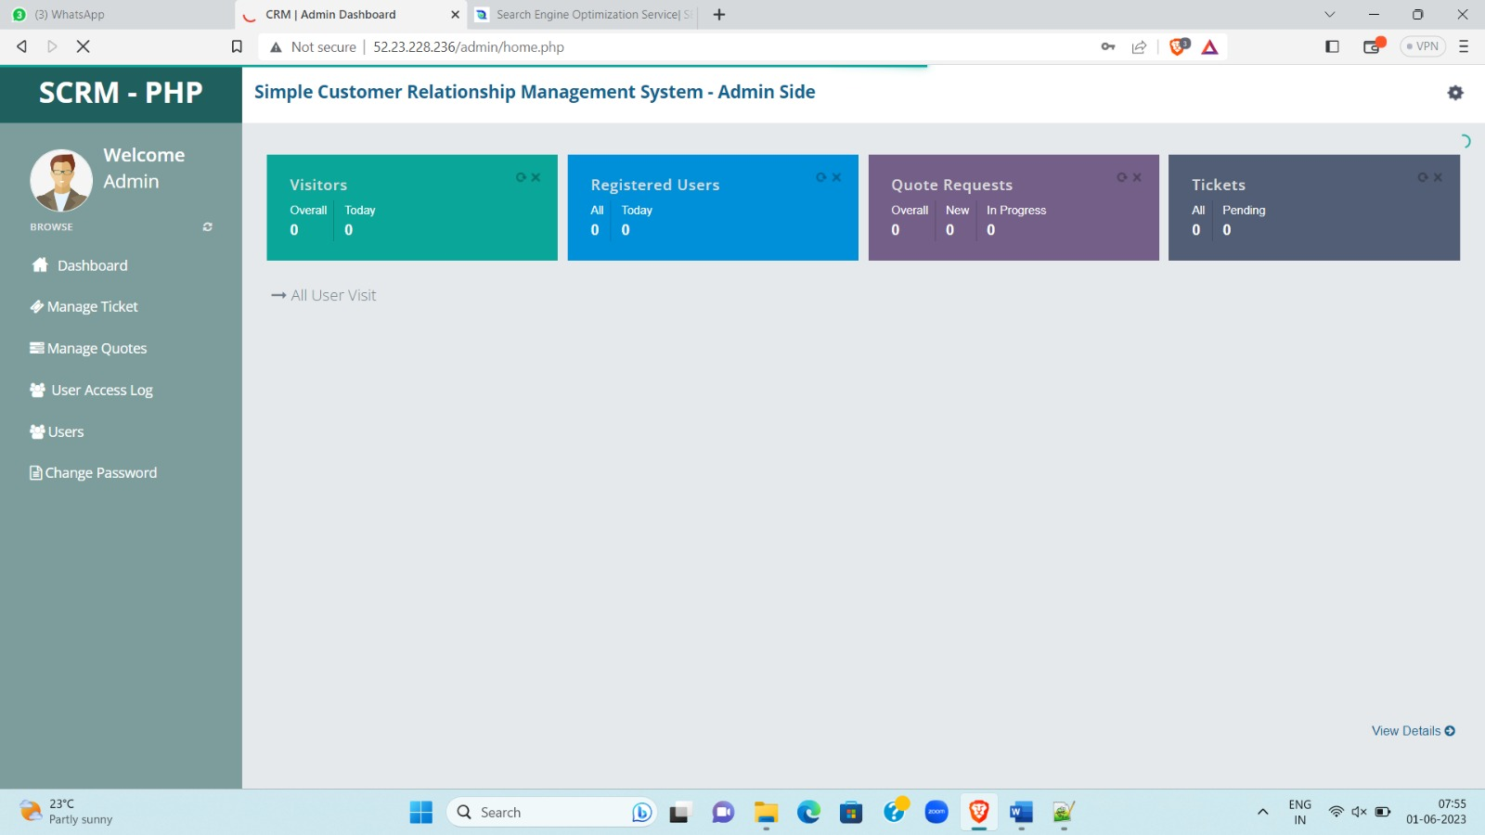
Customer Relationship Manager

Slide 11
THANK YOU

